Slide 1
Coordinated Entry System
Designing and Implementing Coordinated Entry in the Alaska Balance of State CoC
Mike Lindsay, ICF
Ryan Burger, ICF
Christine Nguyen, ICF
Carrie Collins, Alaska Housing Finance Corporation
Brian Wilson, Alaska Coalition on Housing and Homelessness

Slide 2
Agenda
Welcome and Introductions
Overview of Coordinated Entry Background
Introduction to Components of Coordinated Entry
Review of Planning Guide and Process
Expectations and Next Steps: Local Leadership

Slide 3
Welcome and Introductions

Slide 4
Welcome and Introductions
Your Presenters
Brian Wilson, Executive Director, Alaska Coalition on Housing and Homelessness
Carrie Collins, Alaska Housing Finance Corporation
Mike Lindsay, HUD Technical Assistance Provider at ICF
Ryan Burger, HUD Technical Assistance Provider at ICF
Christine Nguyen, HUD Technical Assistance Provider at ICF
Webinar Logistics
This webinar is being recorded
Slides will be available after the webinar
All attendees are currently muted
To submit a question: Type your question in the Q&A box (select either “all participants” or “all panelists”)
To ask a question: Raise your hand and you will be unmuted (functionality only available for those who have called in via phone)
Please submit any technical issues related to WebEx in the chat box

Slide 5
What You Can Expect From the Committee
Forming CES Planning Committee at the CoC
Developing CES Policies and Procedures/Written Standards
Addressing the use of HMIS in coordination with other CoCs
Researching other models of CES in Balance of State CoCs
Implementing statewide CES standards
Aligning CES system design with HUD’s requirements
Learning from local stakeholders about resources and how to implement the Coordinated Entry System across the CoC
Next Steps:
Identify the current status of regional homeless service coordination
Develop a schedule and process for the CE Planning Committee
Get started

Slide 6
Overview of Coordinated Entry Background

Slide 7
Call to Action of the HEARTH Act
The call to action of the HEARTH Act
“Transform homeless services into crisis response systems that prevent and end homelessness and rapidly return people who experience homelessness to stable housing.”
Purpose of the HEARTH Act
Consolidate homeless assistance programs
Codify the Continuum of Care planning process
Establish a goal of ensuring that families who become homeless return to permanent housing within 30 days
Establishing a Coordinated Entry System has been a requirement since 2012 (CoC Program interim rule)
HUD has established a deadline of January 23, 2018 for CoCs to establish or update their Coordinated Entry System (Notice CPD-17-01)

Slide 8
Moving to a Systems Approach To Ending Homelessness
Moving from:
Agency Performance
Unique Agency Intake
Planning in Silos
Haphazard Decisions
Housing Readiness
Automatic Project Renewal
Outdated Program Models
Housing the Next In Line
My Program
Transforming to:
System Performance
Coordinated Entry
System Action Plan
Data Driven Decisions
Housing First
Higher Performing Program Funding
Best Practices
Prioritizing/Serving the most Vulnerable
Our System

Slide 9
Review of the Key Components and Requirements of Coordinated Entry

Slide 10
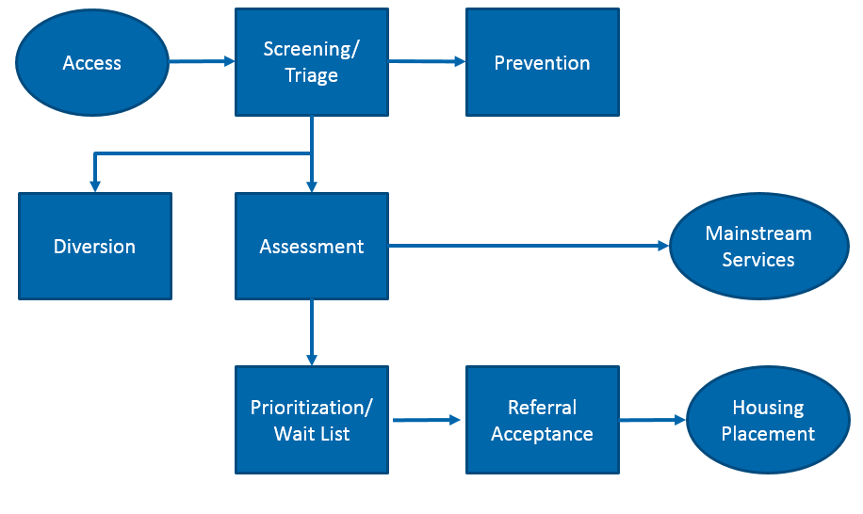
Coordinated Entry Process

Slide 11
Coordinated Entry Process: Access
Access points must offer a standardized approach for homeless households seeking assistance
Access points can be a physical site, a phone hotline, or other appropriate type of access model
Access points engage in diversion strategies
Access points refer to prevention and mainstream services when possible
Access points consider safety concerns when making referrals

Slide 12
Coordinated Entry Process: Diversion
Assisting the household avoid homelessness is always the best outcome
Diversion approaches examine the household’s resources, support network, and housing options to avoid homelessness
Case management can address the underlying issues of the housing crisis

Slide 13
Coordinated Entry Process: Prioritization
Prioritization ensures that scarce housing resources are used effectively
Chronically homeless households and those with high needs and barriers are prioritized for service
Prioritization reflects the unique needs of the local homeless population
Prioritization approach is fair and transparent
Notes:
Prioritization Process:
What is the CoC’s selected standardized assessment and prioritization tool?
In addition to your prioritization tool - which of the following factors are most important to determine your prioritization process?
Significant physical, mental, developmental, or behavioral health disabilities
High utilization of crisis or emergency services (hospitals, jails, etc.)
Unsheltered status
Vulnerability to illness or death due to homelessness
Risk of continued homelessness
Vulnerability to victimization, including assault or trafficking
Do you operate a Permanent Supportive Housing (PSH) project with dedicated and prioritized beds, and do you prioritize based on HUD’s Notice CPD-016-11?

Slide 14
Coordinated Entry Process: Referral Process
Vacancies in a program are filled through the Coordinated Entry System
Households are referred to programs for which they are eligible
Client choice informs the referral process
Programs use a Housing First approach to lower barriers and ensure that high-need households receive assistance
Notes:
Referral Process:
Are program and project eligibility criteria appropriate for the needs and barriers of homeless households within your CoC?
Are all programs and projects committed to accepting referrals and filling vacancies through the Coordinated Entry System?
How is client information managed? Is it shared in a streamlined manner?
If a recommended housing option is not available for a household, what process ensures that the household is quickly sheltered?
How is this process informed by client choice?
Does all eligibility criteria comply with laws and regulations related to fair housing, equal access, and civil rights?
As a reminder:
Housing First is a model of housing assistance that prioritizes rapid placement and stabilization in permanent housing that does not have service participation requirements or preconditions (such as sobriety or a minimum income threshold).
Supportive services are offered to maximize housing stability and prevent returns to homelessness as opposed to addressing predetermined treatment goals prior to permanent housing entry.
In recent CoC Program Competitions, CoCs were given points based on how their permanent housing project applications committed to applying the Housing First model. Providers that were awarded funding having stated in their project application that they were using a Housing First approach are required to operate as such.
Housing First is a model of housing assistance that prioritizes rapid placement and stabilization in permanent housing that does not have service participation requirements or preconditions (such as sobriety or a minimum income threshold).
Supportive services are offered to maximize housing stability and prevent returns to homelessness as opposed to addressing predetermined treatment goals prior to permanent housing entry. This approach removes unnecessary barriers and assumes that supportive services are more effective in addressing needs when the individual or family is housed – when the daily stress of being homeless is taken out of the equation. Key components of this model include a simple application process, a harm reduction approach, and no conditions of tenancy beyond those included in the lease. This approach is highlighted in Opening Doors as a core strategy for ending homelessness.
Characteristics of the Housing First Model may include the following--
Direct, or nearly direct, placement of targeted homeless people into permanent housing.
Supportive services that are offered and readily available, but not required to remain in housing.
Assertive outreach to engage and offer housing to homeless people.
Low demand approach that accommodates client alcohol, substance use and symptoms of mental illness.
Continued effort to provide case management

Slide 15
Coordinated Entry Process: Housing Placement
Programs accept households from the Coordinated Entry System
Clients are not screened out of a program because of real or perceived barriers related to housing or services
Equal access and fair housing protections ensure households are not steered to any particular program
Households achieve permanent housing as quickly as possible

Slide 16
AK BoS Planning Process

Slide 17
Coordinated Entry Planning
The following planning guide will be made available to assist regions in considering how to implement a Coordinated Entry System at the state and local level
This planning guide is specifically designed to support your collaborative process for making decisions
Consult HUD’s Notice CPD-17-01 (Requirements of a Coordinated Entry System) for specific requirements of CES
The CoC’s Coordinated Entry Planning Committee and ICF are available to assist and support local and regional conversations and decision-making processes

Slide 18
Planning and Stakeholder Consultation
HUD requires CoCs to facilitate ongoing planning and stakeholder consultation concerning the implementation of CES
CoCs must solicit feedback at least annually from participating projects and from households that participated in CES
Feedback must address both the quality and the effectiveness of the system

Slide 19
Coordinated Entry Planning – Phase 1
System Design
Planning Considerations
System Review and Mapping Utilizing HMIS data
Utilizing HMIS data identify the current flow and inefficiencies within your current system design
By analyzing local data including entry/exit, length of stay and project utilization rates, communities can begin to identify:
Who are we really serving in our homeless response system?
How are they accessing our services?
Where do homeless individuals and families reside prior to entering the homeless system?
How are we serving homeless individuals and families?
Where do individuals and families go after they leave the homeless system?
How long does our system keep individuals and families in a state of “homelessness”?
Are we efficient?
Identify or develop access models – including capacity and resources
Physical locations
Virtual locations
Mobile locations
Co-located services/HUBs?
What exists in your communities today that can utilized or expanded?
What needs to be developed to increase fair and equal access to services?

Slide 20
Coordinated Entry Planning – Phase 1
System Design
Develop assessment phases and structure
Initial triage
Diversion
Preventing screening
Non-prioritized emergency services
Assessment for prioritization
Assessment for eligibility
Develop prioritization list structure
Design a specific and definable set of criteria to apply consistently throughout the CoC for all populations
Directly written into Polices and Procedures
Consistent with the CoCs Written Standards
Develop referral process work flow
Process includes uniform and coordinated referral process for all homeless beds/units
Define eligibility criteria and lower barriers to entry

Slide 21
Coordinated Entry Planning – Phase 2
Policy Development
Define standardization of policies across regions – identify policies/areas for local flexibility
Define components of Coordinated Entry that require Board involvement/approval
Develop and approve CoC Written Standards
Eligibility
Prioritization
Level of service
Lower barriers
Increase access to services
Develop requirements for access points
Use of common assessment tool, use of HMIS, timeliness of referrals, engagement in diversion/prevention, hours of operations, etc.
Develop/adopt prioritization policies
Develop referral policies within and across regions
Develop and adopt Housing First requirements
Develop referral acceptance/denial and termination policies – client grievance policy
Develop performance requirements for participating providers

Slide 22
Coordinated Entry Planning – Phase 3
Process and Procedure Development
Process and procedures are informed by policies that define how the system operates
Develop an assessment process
Phases of data collection and entry procedures
Potentially at different points in time and by different providers
Develop referral process
Determine how a referral is made
Develop process for providers to accept a referral and provider expectations and requirements
Develop referrals to mainstream resources, both before and after project enrollment
Determine how, when and under what circumstances a recommended assessment, referral or prioritization result can be overridden and by whom
Determine use of case conferences
Establish out-flow/move-up strategies to support client exits from homeless programs
Determine appropriate training supports
Determine the role of an oversight entity/coordinated entry system manager is needed

Slide 23
Coordinated Entry Planning – Phase 4
HMIS Work Flow Development
Identify what components of coordinated entry will be supported by or managed by HMIS
Work with ICA to customize HMIS work flows based on designed CES work flow and phases
Identify what client level data will be collected at each phase of the assessment and referral process
Determine if additional data elements need to be collected to support CES operation and/or evaluation
Develop user guides and material to support HMIS work flows
Assess privacy policies and data sharing opportunities/constraints with mainstream providers
Assess HMIS licensing and privacy/data sharing agreements with mainstream providers

Slide 24
Next Steps
Questions
Comments
Next Steps

