Slide 1
Fairbanks Housing & Homeless Coalition
Strategic Planning 2020

Slide 2
Agenda
Introductions
Current Situation
2020 data highlights
2019 plan
Ten Year Plan (drafted in 2013, last formal review in 2018)
Service Gaps
Open discussion of service gaps
Survey results (survey report contains unedited public comments)
Begin brainstorming projects to mitigate or eliminate service gaps
Set next meeting date/time

Slide 3
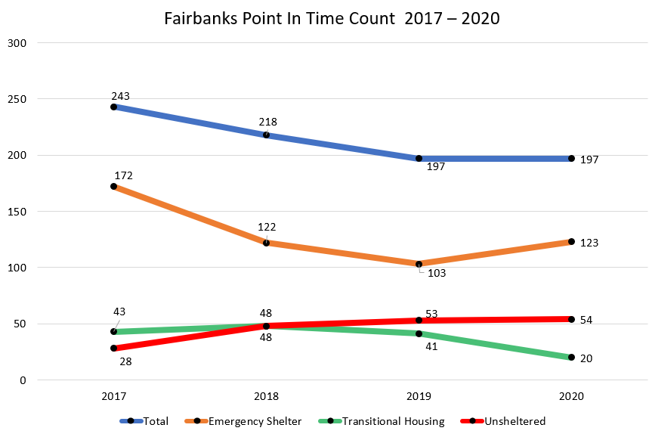
DATA HIGHLIGHTS

Slide 4
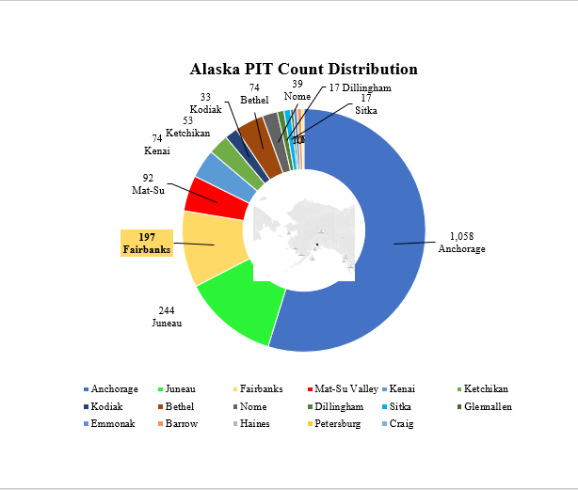
DATA HIGHLIGHTS
Alaska 4 year average: 1,930 people
Fairbanks percentage of total:
2017: 13.2%
2018: 10.8%
2019: 10.7%
2020: 10.1%

Slide 5
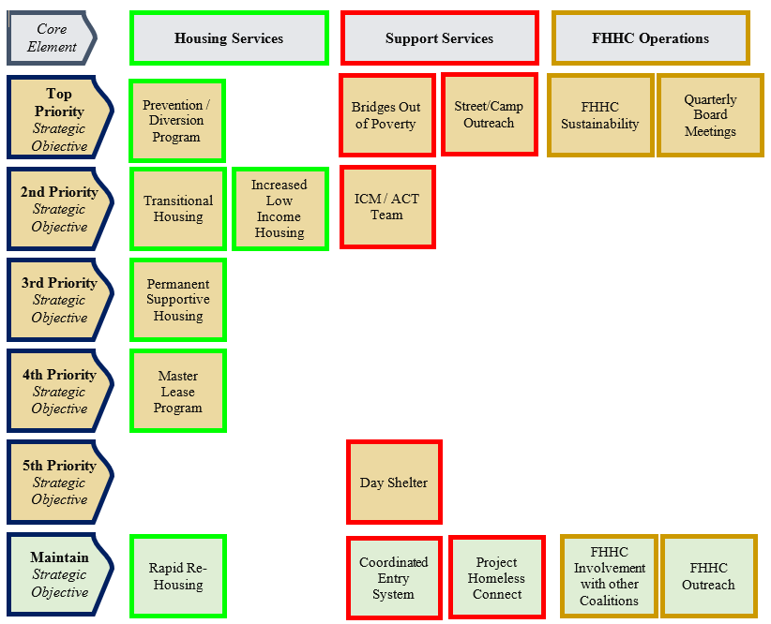
2019 PRIORITIZATION

Slide 6
Additional TYP Objectives
Host Homes for Youth
Advocate for Behavioral Health options
Increase HMIS participation

Slide 7
Service Gaps?
________________________________________________________
________________________________________________________
________________________________________________________
________________________________________________________
________________________________________________________

Slide 8
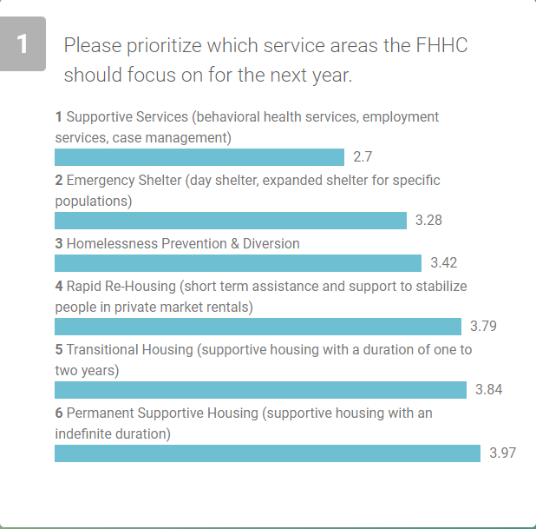
Survey Highlights

Slide 9
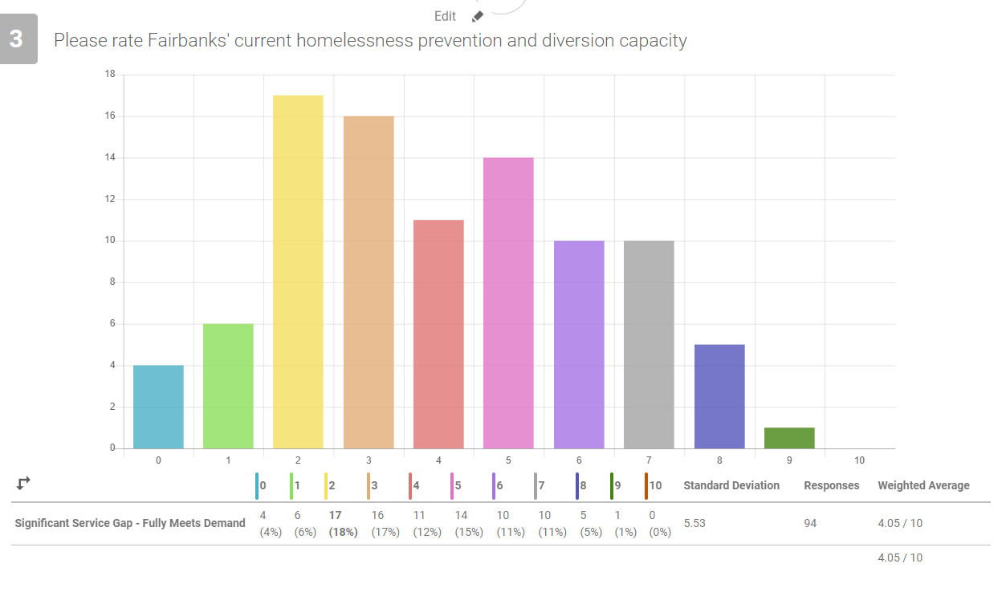
Survey Highlights

Slide 10
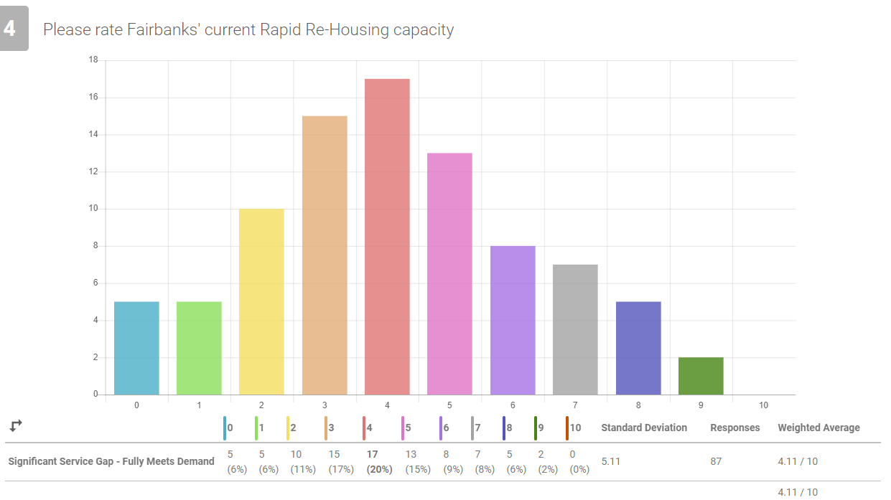
Survey Highlights

Slide 11
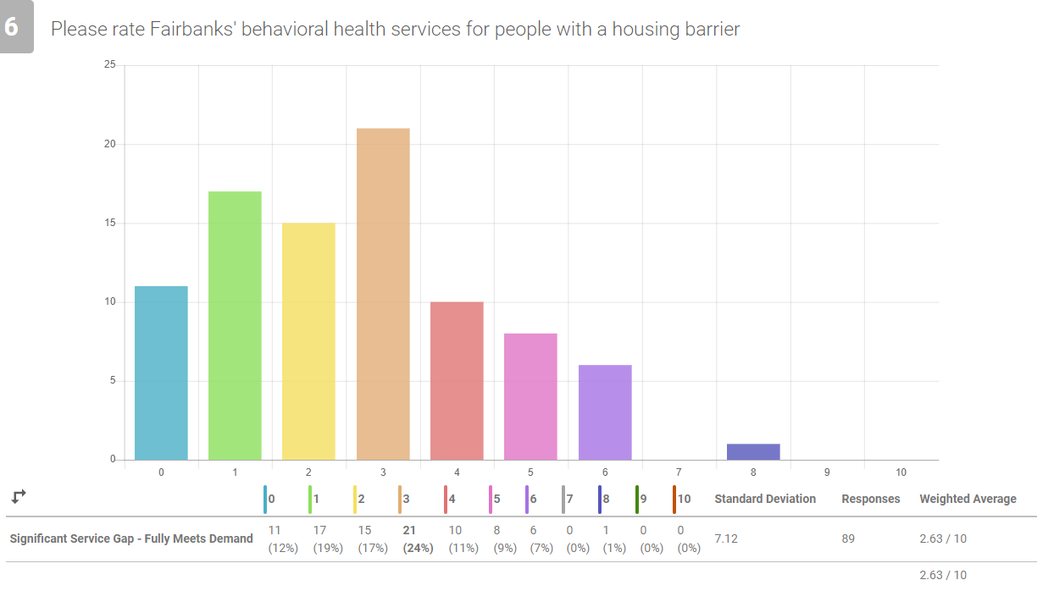
Survey Highlights

Slide 12
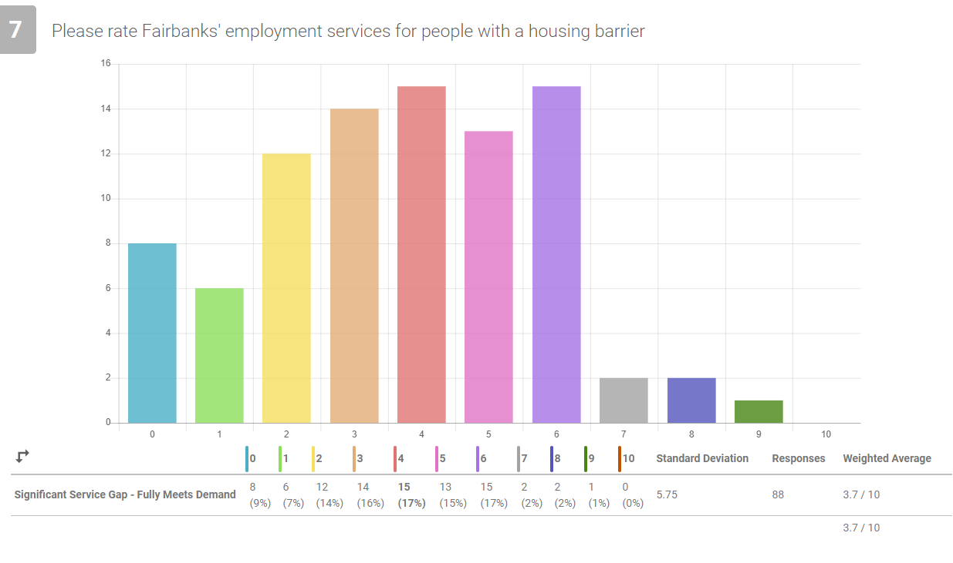
Survey Highlights

Slide 13
Next Meeting?

Slide 14
Planning Session II

Slide 15
Identified Service Gaps
Senior Housing: The waitlist for subsidized senior housing is nine months to two years long currently and the senior population in Fairbanks will double over the next ten years.
Behavioral Health Services: Local behavioral health service capacity is less than current demand for services, particularly for people that are unwilling or unable to make an office appointment.
Transitional Housing for 18-25 year old people: Current national best practices promote 18 -24 months of supportive housing for transitional age youth. We don’t have youth transitional housing in Fairbanks.
Long-Term Case Management: We discussed the need for case management beyond initial stabilization services.

Slide 16
Identified Service Gaps
Permanent Supportive Housing for SMI/Dual Diagnosis: Fairbanks has a lack of PSH for people with severe mental illness or dual diagnosis. The Coordinated Entry System (CES) Prioritization List has people that fit this description who do not seem eligible for existing PSH or have been removed from local PSH (typically due to safety concerns for other residents)
Peer Support / Service Navigation: We discussed the need for expanding local peer support / service navigation programs.
Service options for people trespassed from current services: Every year we have several people that fall through the cracks by “burning bridges” at multiple organizations in a short period of time. Typically, people are accepted back into the services after a period of time depending upon the reason for the trespass and the agency, but often the time that they are trespassed is when they need the most help. We discussed the need for a no barrier crisis management service similar to Crisis Now.
LGBTQ Host Home Program: Fairbanks does not currently have a LGBTQ Host Home program similar to Choosing Our Roots in Anchorage.
Plan for increased homelessness: We had some discussion about the need to be prepared for increased homelessness due to COVID-19.

Slide 17
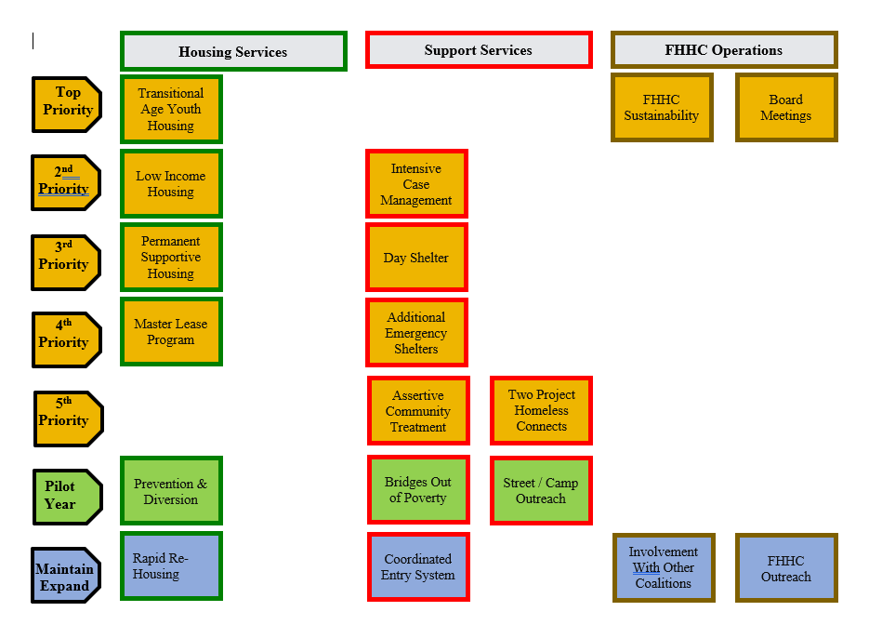
2020 PRIORITIZATION

Slide 18
Project Ideas?
________________________________________________________
________________________________________________________
________________________________________________________
________________________________________________________
________________________________________________________

